Slide 1


DATA SCIENTISTS JOB ANALYSIS

Slide 2
PROBLEM DESCRIPTION:
A data scientist’s role has being gaining a lot of importance in recent times and the demand for its job is keep on increasing day by day.
In this mini-project, we will analysing all the factors that are related to a data scientist job like person’s salary, about his company, the skills required, etc.
In order to analyse these factors, we will be using various probability concepts those are familiar to us.

Slide 3
SCOPE:
We will be able to decide which type of data scientist job is highly paid.
We will get to know the skills that we as data scientist have to possess in order to achieve success.
It will be useful for us to choose the job at the time of placements.

Slide 4
DATASET:

Slide 5
DATASET EXPLANATION:
The data is about the role of data scientists in various companies along with their required fields.
The dataset consists of 22 columns and 743 rows.
The columns has the following details:
Job Title – The name of the data scientist job
Salary estimation – Approximate range of salary
Rating – Star rating out of 5 for the company
Company – Name of the company
Location – The place where the company is located
Headquarters – The place where the company’s headquarters is located
Size – The range of employees employeed in the company
Founded – The year in which the company was found
Type of ownership – The company’s ownership type
Industry – The industry to which the company belongs to

Slide 6
DATASET EXPLANATION:
Sector – Sector name of the company
Revenue – The range of revenue of the company
Competitors – The name of the company that competes with this company
Min_salary – Minimum salary for the given job
Max_salary – Maximum salary for the given job
Avg_salary – Average salary for the given job
Job_state – The state in which the job role is found to be popular
Same_state – Is this company’s state is same as that of the job state
Age – Total number of years since the company has been found
Python_yn – Whether the employee uses python or not
R_yn – Whether the employee uses R programming or not
Spark & Aws – Whether this framework is used or not
Excel – Whether the employee uses excel or not

Slide 7
CONCEPTS USED:
PROBABILITY DISTRIBUTIONS:
DISCRETE RANDOM DISTRIBUTIONS:
BERNOULLI DISTRIBUTION:
A Bernoulli distribution is a discrete probability distribution for a Bernoulli trial — a random experiment that has only two outcomes (usually called a “Success” or a “Failure”). The probability of “success” is P and probability of “failure” is 1-P. It is a special case of the binomial distribution for n = 1.
BINOMIAL DISTRIBUTION:
A binomial distribution can be thought of as simply the probability of a SUCCESS or FAILURE outcome in an experiment or survey that is repeated multiple times. The binomial is a type of distribution that has two possible outcomes (the prefix “bi” means two, or twice).
NORMAL DISTRIBUTION:
A normal distribution, sometimes called the bell curve, is a distribution that occurs naturally in many situations.

Slide 8
POISSON DISTRIBUTION:
A Poisson distribution is a tool that helps to predict the probability of certain events happening when you know how often the event has occurred. It gives us the probability of a given number of events happening in a fixed interval of time.
GEOMETRIC DISTRIBUTION:
The geometric distribution represents the number of failures before you get a success in a series of Bernoulli trials.
CONTINUOUS RANDOM DISTRIBUTIONS:
UNIFORM DISTRIBUTION:
In statistics, uniform distribution is a term used to describe a form of probability distribution where every possible outcome has an equal likelihood of happening. The probability is constant since each variable has equal chances of being the outcome.

Slide 9
CONDITIONAL PROBABILITIES:
The conditional probability of the event is the probability that the event will occur, provided the information that an event A has already occurred.
HYPOTHESIS TESTING:
Large Sample Tests:
The sample size n is greater than 30 (n≥30) it is known as large sample. For large samples the sampling distributions of statistic are normal(Z test).
Z-Test:
A z-test is a statistical test used to determine whether two population means are different when the variances are known and the sample size is large.
Small Sample Tests:
If the sample size n is less than 30 (n<30), it is known as small sample. For small samples the sampling distributions are t, F and χ² _{distribution.}
T-test:
A t-test is a type of inferential statistic used to determine if there is a significant difference between the means of two groups, which may be related in certain features.

Slide 10
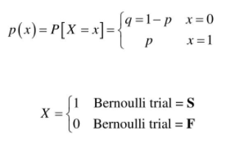
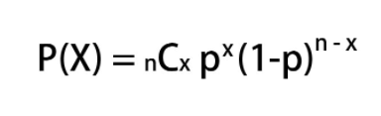
CALCULATION:
BERNOULLI DISTRIBUTION:
Python function: Bernoulli. rvs (parameters)
BINOMIAL DISTRIBUTION:
Python function: Binom. pmf (parameters)

Slide 11
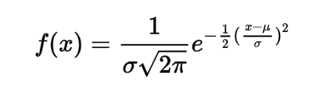


NORMAL DISTRIBUTION:
Python function: np. random. normal(parameters)
POISSON DISTRIBUTION:
Python function: poisson. rvs (parameters)
GEOMETRIC DISTRIBUTION:
Python function: geom. pmf (parameters)

Slide 12
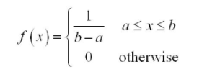
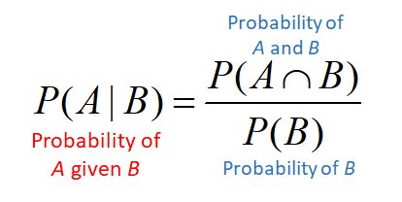
UNIFORM DISTRIBUTION:
Python function: uniform(parameters)
CONDITIONAL PROBABILITES:
No direct Python function

Slide 13


HYPOTHESIS TESTING:
Z-TEST:
Python function: critical z-value: norm. ppf(parameter)
z-test value: ztest (parameters)
T-TEST:
Python function: ttest_ind(parameters)

Slide 14
ALGORITHM:
The dataset is extracted from Kaggle.
Importing the dataset into python jupyter notebook using pandas.
Followed by importing, Data Cleaning process is held out.
Various probability distributions are implemented for the data like, Bernoulli, binomial, normal, geometric, poisson and continuous uniform distributions.
Next, we made some conclusions from conditional probabilities, i.e, finding the probability of a event, given an event has already occurred.
Then, hypothesis test was carried out for testing of the dataset.
Z-test was carried out for large sample sizes.
T-test was carried out for small sample sizes.
Run the program at each levels.

Slide 15
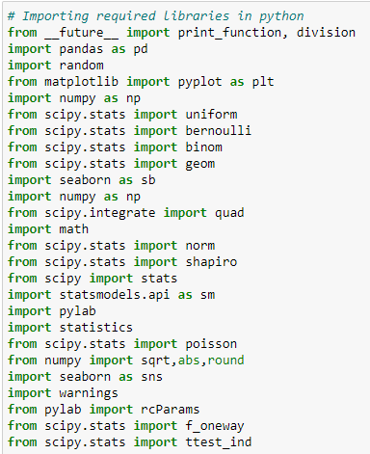
CODING & OUTPUT:
IMPORTING NECESSARY LIBRARIES & DATASET:

Slide 16
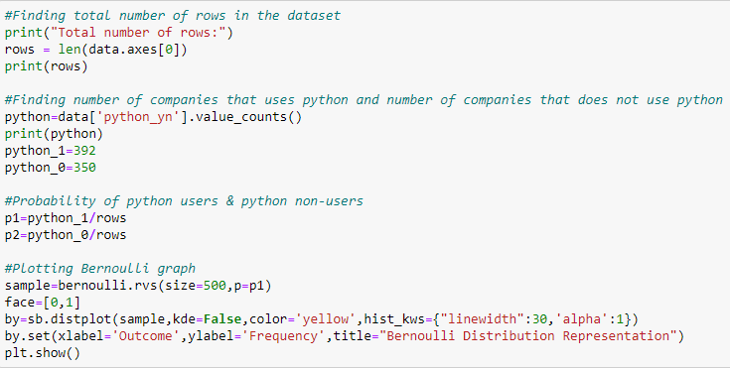

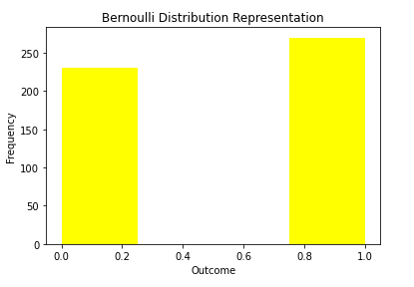
BERNOULLI DISTRIBUTION:

Slide 17
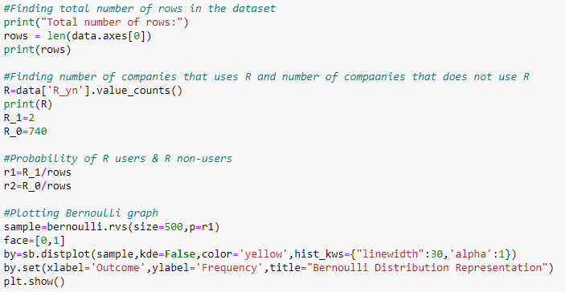

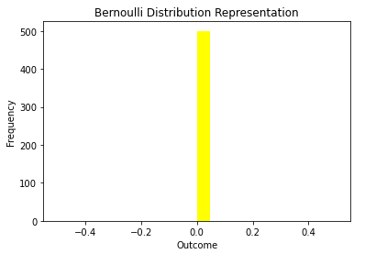

Slide 18
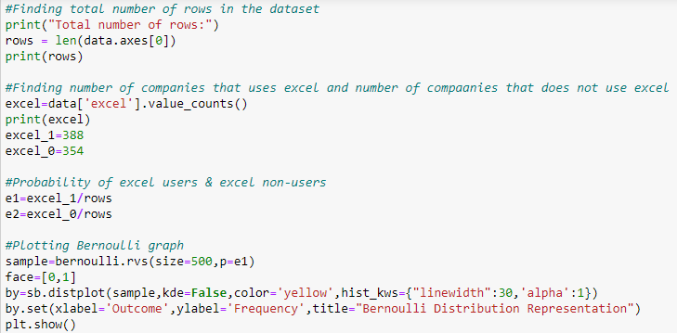
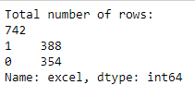
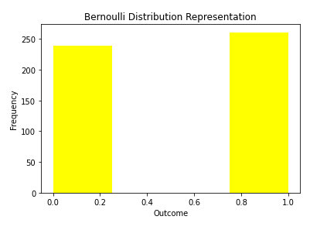

Slide 19
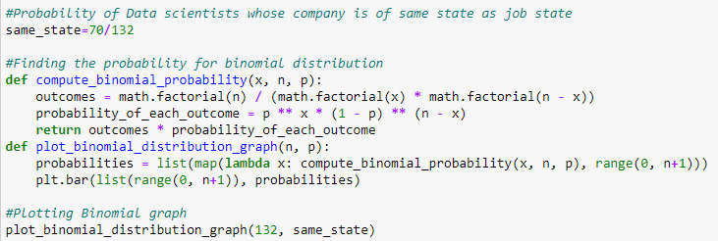
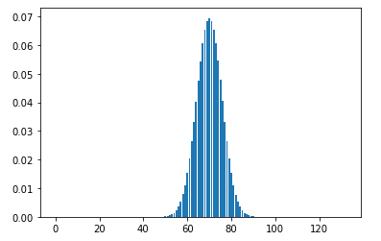
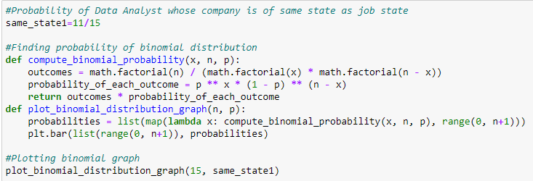
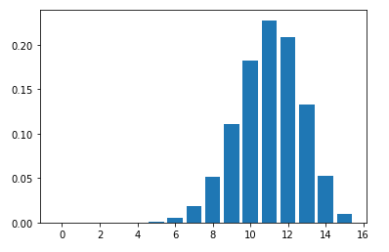
BINOMIAL DISTRIBUTION

Slide 20
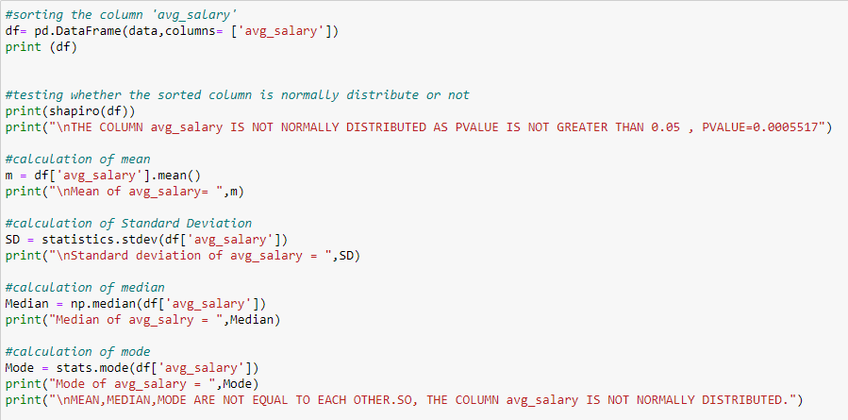
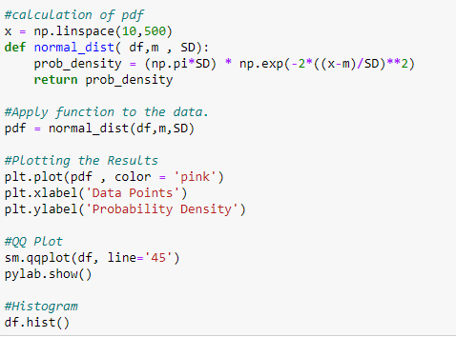
NORMAL DISTRIBUTION:

Slide 21
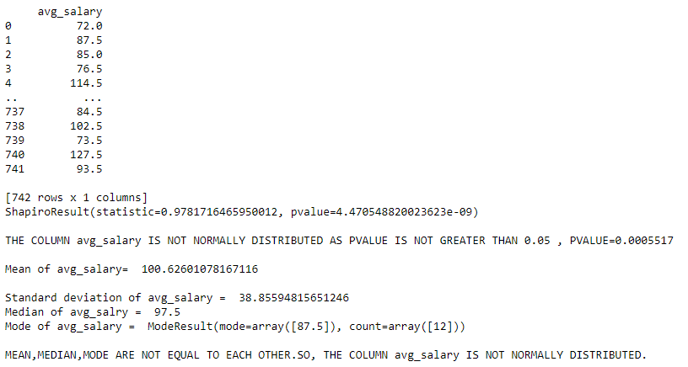
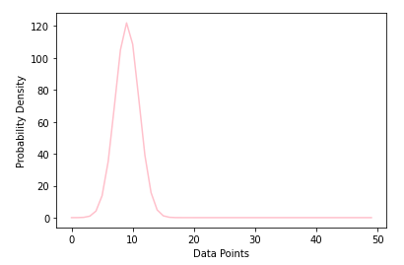
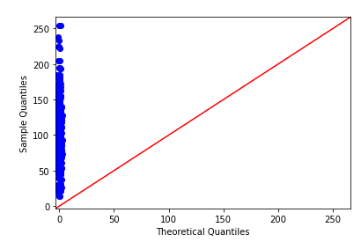
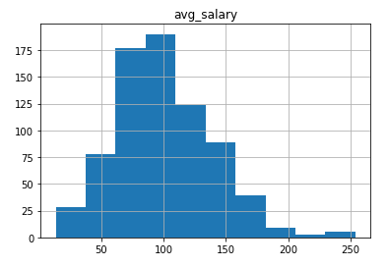

Slide 22
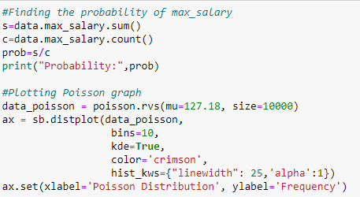
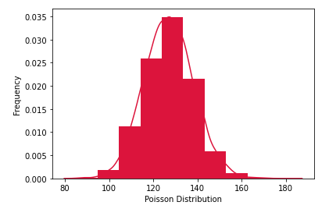
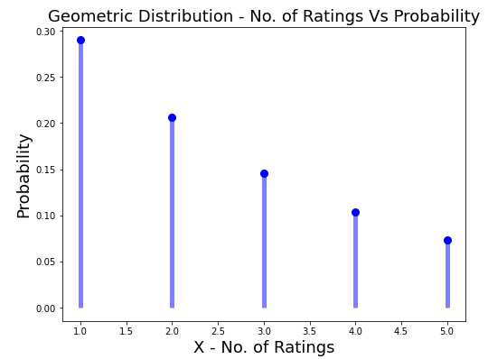
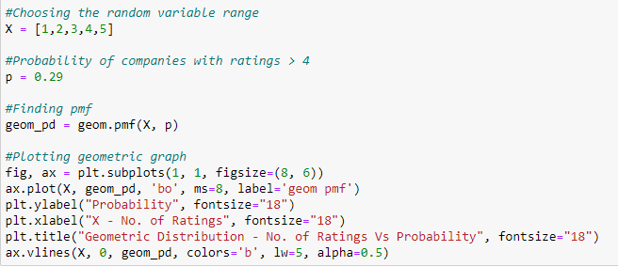
POISSON DISTRIBUTION:
GEOMETRIC DISTRIBUTION:

Slide 23
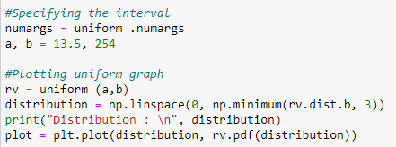
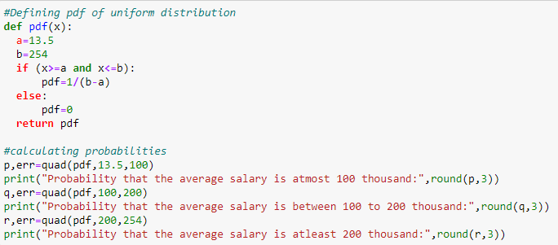
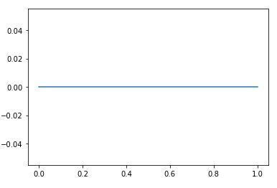

CONTINUOUS UNIFORM DISTRIBUTION:

Slide 24
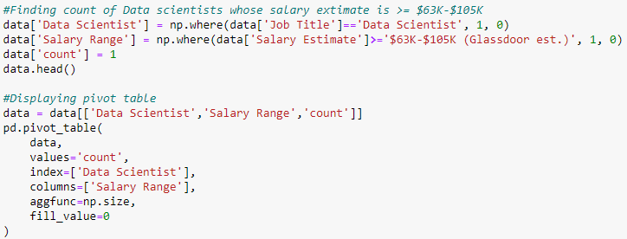
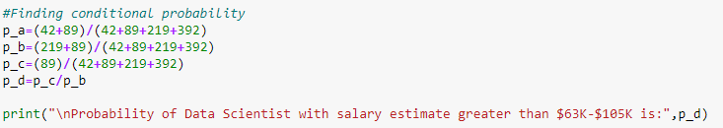
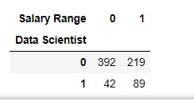
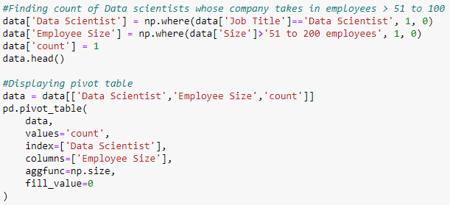
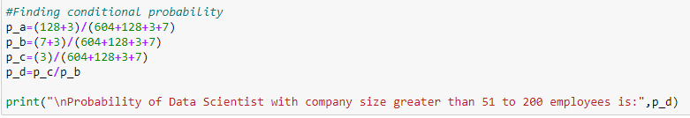
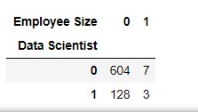
CONDITIONAL PROBABILITY
CONDITIONAL PROBABILITIES:

Slide 25
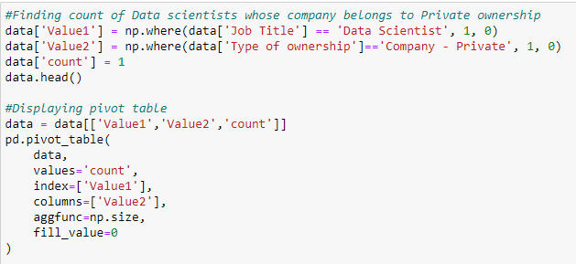
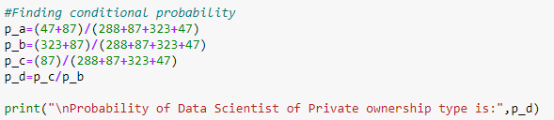
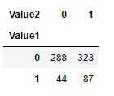
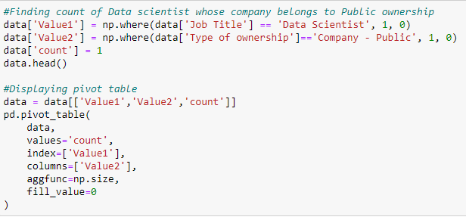
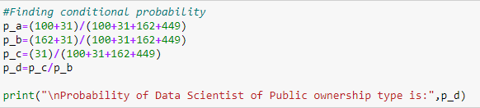
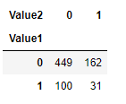

Slide 26
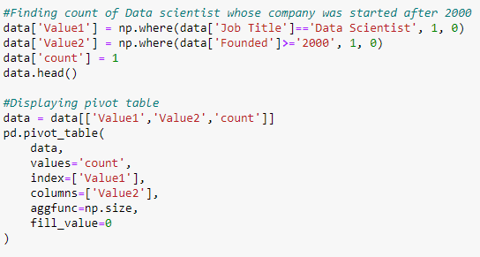
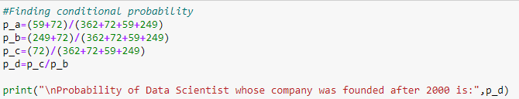
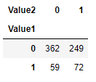
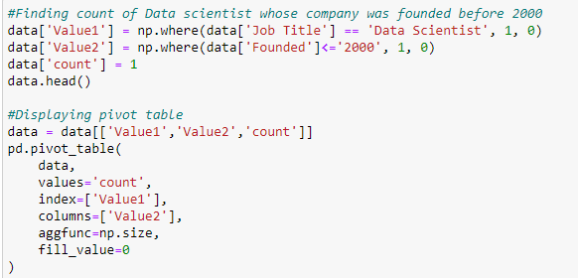
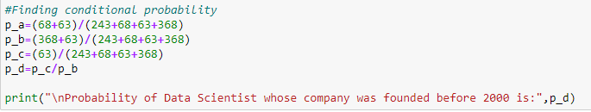
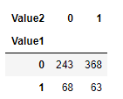

Slide 27
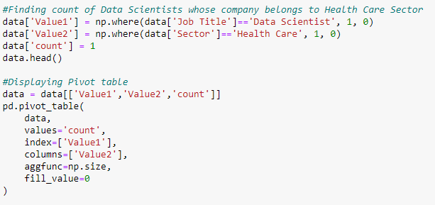
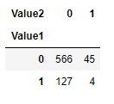


Slide 28



HYPOTHESIS TESTING:
Z-TEST:

Slide 29




Slide 30




Slide 31








T-TEST:

Slide 32






Slide 33
CONCLUSIONS:
Priority of programming languages is Python > Excel > R
The company having its setup in the same state as the job state is not found to be equally likely.
The average salary of the employees are not normally distributed.
Nearly 36% of the employees get an average salary of atmost 1 lakh.
Nearly 42% of the employees get an average salary between 1 lakh to 2 lakhs.
Nearly 23% of the employees get an average salary of more than 2 lakhs.
29% of the data scientists get an salary estimate greater than $63k - $105k.
30% of the data scientist’s company recruit employees with the size of 51 to 200 employees.
8% of the data scientists work in the Health care sector.

Slide 34
21% data scientists work in the company having Private Ownership.
16% data scientists work in the company having Public Ownership.
22% of the data scientists in the company founded after 2000 .
16% of the data scientists in the company founded before 2000.
Both Data Scientists and Data Engineers perform equally with respect to average salary.
The average salary of the Data Scientists is equal to or greater t 101k.
The average salary of the Data Scientist does not depend on the ratings of the company.
Data Analyst and Data Engineers have different salary with Data Engineers getting the greater salary.

Slide 35
THANK YOU

